Slide 1
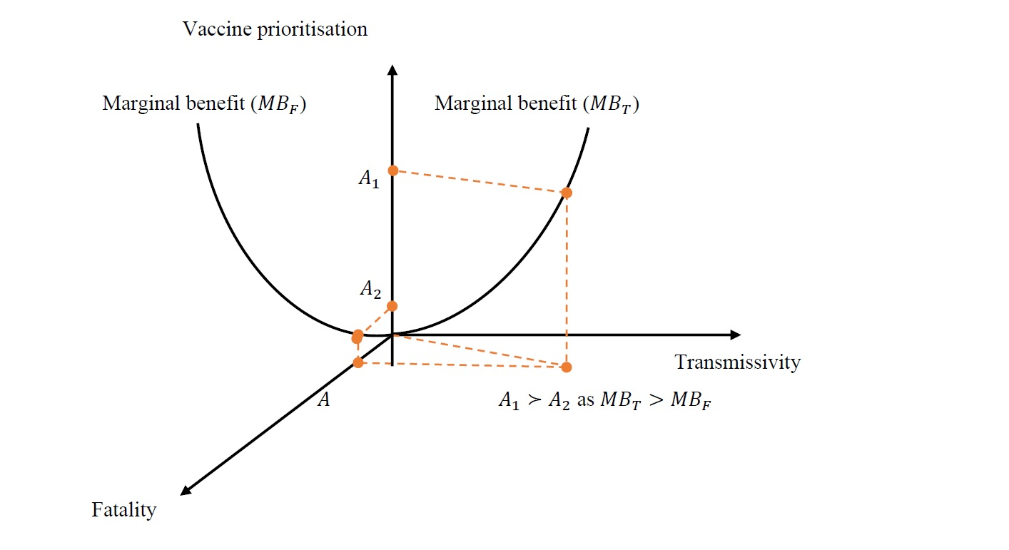
Economics of the Real World in Twelve Lessons
Wong Chin Yoong, Ph.D

Slide 2
Speaker’s profile
Associate professor in economics, Universiti Tunku Abdul Rahman
Distinguished visiting professor, University of Sanya
Associate Research Fellow, Malaysian Institute of Economic Research
Visiting Research Fellow, Stockholm China Economic Research Institute
Economic Advisor to Institute of Strategic Analysis and Policy Research
Columnist, Nanyang Siang Pao
Programme host, 8TV Money Matters
External Educational Advisor to Max Wealth Education Sdn Bhd

Slide 3
What we’re going to learn?
Lesson I: Opportunity cost
Spend now or save for latter?
Lesson II: Marginal cost and benefit
Why MNCs slice their value chains?

Slide 4
12 economic lessons
Lesson III: Supply and demand
Why commodity prices nosedive in last April but skyrocket since then?
Government keeps raising sin tax not just because the product is sinful
Price your product/service higher neither necessarily boost nor slash your sales revenue
Lesson IV: Diminishing marginal return vs. increasing return to scale
No country can grow exponentially forever
Winners-take-all economy

Slide 5
First micro
Lesson V: Externalities
No one is safe until everyone is safe
Encouraging recycling
Putting a price tag on CO₂ emission
Lesson VI: Informational asymmetries
Market for lemons
Why higher interest rate is not necessarily at banks’ best interest

Slide 6
Next macro
Lesson VII: Internal and external balances
Don’t be too happy with two decades of trade surplus
Worry about budget deficit for the right reason
Lesson VIII: Money supply and inflation
Where’s the inflation during massive QE?
Lesson IX: Natural rate of interest
Why interest rates are so low?

Slide 7
And finance
Lesson X: Expectation hypothesis
Yield to maturity tells more about the economy than the stock market
Lesson XI: Government debt
Who says Malaysia is going to bankrupt?
Lesson XII: Safe assets
Why the U.S dollar often appreciates whenever the U.S and the world were in trouble?

Slide 8
Lesson I: Opportunity cost

Slide 9
Every decision has an opportunity cost
You probably have faced such a dilemma: work harder or more free time for family?
Apparently you cannot spend more time with family without letting go time spent on work
Another way of expressing this is to say that free time has an opportunity cost: to get more free time for family, you forgo the opportunity of earning more money/ getting work done earlier/being promoted
It is not just about the monetary cost incurred when doing something that matters, the opportunity cost involved for not being able to do something else also matters. We call it economic cost.

Slide 10
Opportunity cost shapes behaviour
Life is about making choices on what to do and what not to do, what shall be done first and what’s next. Examples:
  An adult spends hours and thousands to sit for a class
  A commuter takes the train to work instead of driving
  A manufacturer chooses to do fully automated OEM
  Government swings between total or partial lockdown

Slide 11
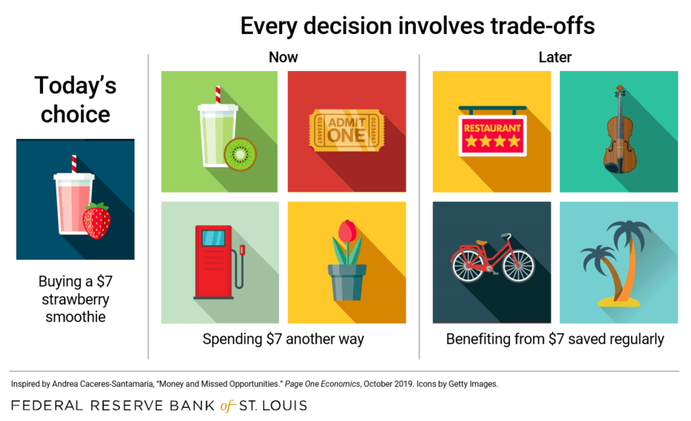
And the trade-offs can be both inter- and intra-temporal

Slide 12
From the trivial RM7 per day to RM87493 in 20 years? People will save if they know opportunity cost of not doing so

Slide 13
And opportunity cost comes from scarcity
Save to buy a house
Choice A is equivalent to choice B in terms of satisfaction
A
B
Indifference curve (IC)
More vacations

Slide 14
How nice it is if we can keep going vacations and continue saving for the dream house
Save to buy a house
Choice B is preferred to choice A
B
IC2
A
IC1
More vacations

Slide 15
But facing everyone is a budget
Save to buy a house
You can’t have more vacations if you wanna save more
A
Delay purchase of dream house for more vacations
B
Budget line
More vacations

Slide 16
Even rich people need to choose (of course their choice space is much larger)
Save to buy a house
BL2
BL1
B
A IC2
IC1
More vacations

Slide 17
In conclusion
Econ 101: we acknowledge scarcity
In response: every decision has an opportunity cost
Therefore, economics as decision analysis is about how to make an optimal choice
For that, we move on to next lesson: marginal cost and benefit

Slide 18
Lesson II:
Marginal cost and benefit

Slide 19
Marginal analysis is a tool of economic analysis
We make decision incrementally, piece by piece, time by time, rather than in lump sum.
For instance,
we decide what to eat for breakfast in every morning. We never make one breakfast decision for our whole life.
Firms plan hiring position by position, case by case, year by year, but never one decision for the business’s entire life
Government allocates budget year by year, project by project, situation by situation, but never one allocation decision for entire generation

Slide 20
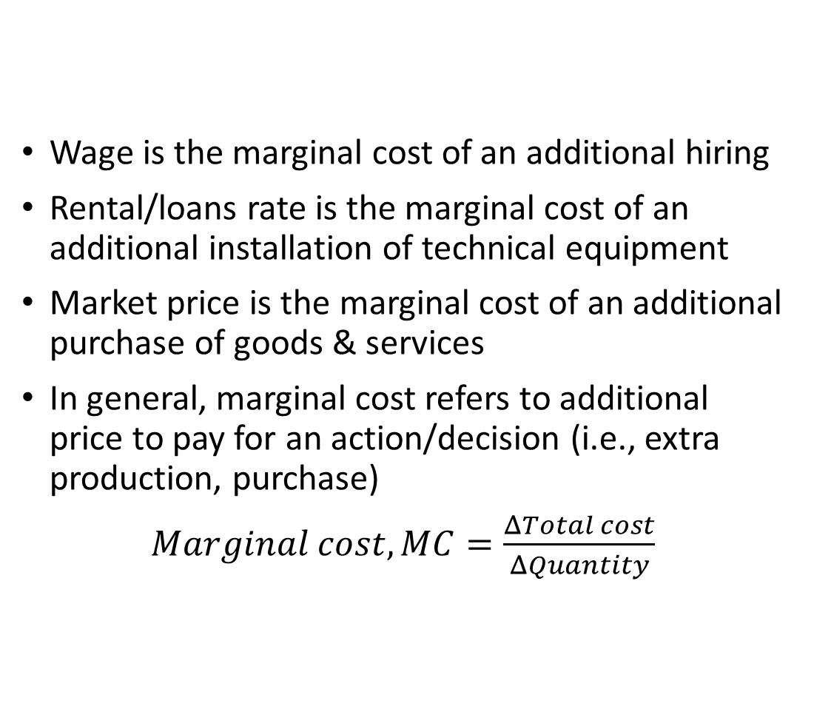
What is marginal cost?
Wage is the marginal cost of an additional hiring
Rental/loans rate is the marginal cost of an additional installation of technical equipment
Market price is the marginal cost of an additional purchase of goods & services
In general, marginal cost refers to additional price to pay for an action/decision (i.e., extra production, purchase)
$Marginal cost,MC=\frac{ΔTotal cost}{ΔQuantity}$

Slide 21

Total cost and marginal cost
Cost
Total cost
$MC=\frac{ΔTC }{ΔQ}$
$ΔTC$
$ΔQ$
Fixed cost > 0
Quantity

Slide 22
MC can be constant, increasing or decreasing over decision, depending on the slack of resources
MC MC MC
Constant Q Increasing Q Decreasing Q

Slide 23
What is marginal benefit?
If wage is the marginal cost of an additional hiring, contribution of the employee to the company is the marginal benefit of an additional hiring (marginal product of labour)
If rental/loans rate is the marginal cost of an additional installation of technical equipment, contribution of the machine to the production is the marginal benefit of an additional hiring (marginal product of capital)
If market price is the marginal cost of an additional purchase of goods & services, it will be the marginal revenue of an additional sale of goods & services

Slide 24

Marginal benefit means the payoff of a decision
In general, marginal benefit refers to additional payoff for an action/decision (i.e., extra production, purchase)
$Marginal benefit,MB=\frac{ΔTotal benefit}{ΔQuantity}$
For producer, marginal benefit of an additional sale of goods & services is marginal revenue
For consumer, marginal benefit of an additional purchase of goods & service is marginal utility

Slide 25
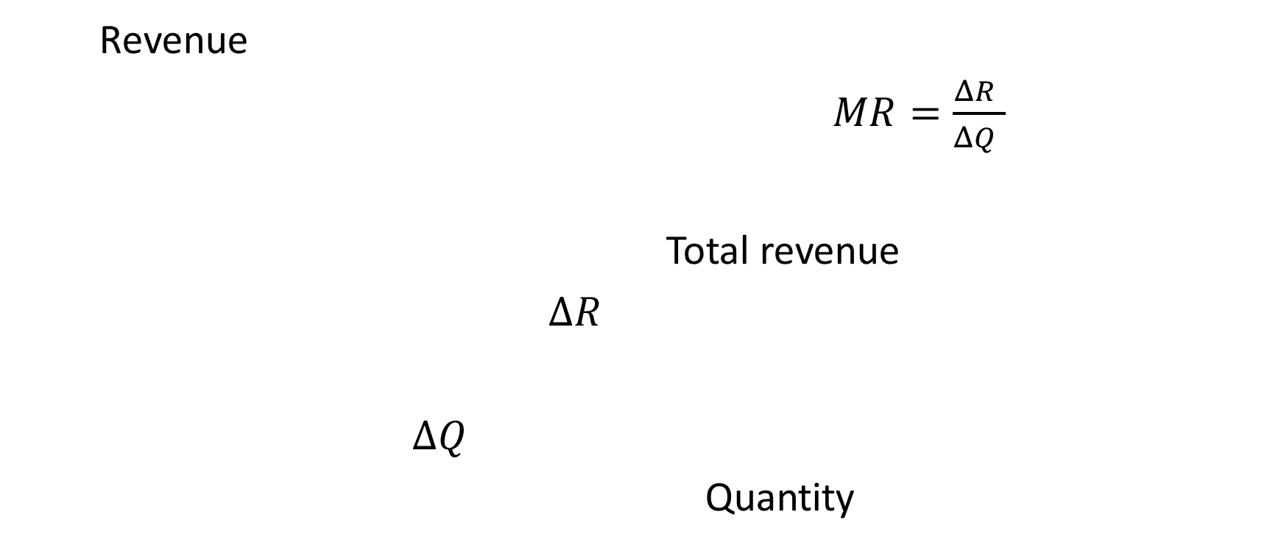
Total revenue and marginal revenue
Revenue
$MR=\frac{ΔR }{ΔQ }$
Total revenue
$ΔR$
$ΔQ$
Quantity

Slide 26

No more, no less
How people make decision at their best interest? They weigh marginal cost and benefit, intentionally or unintentionally, and decide.
If marginal benefit outweighs marginal cost $MB>MC$, do more
If marginal cost outweighs marginal benefit $MB<MC$, do less
When marginal benefit equals marginal cost $MB=MC,$ no more, no less. And this is the optimal decision

Slide 27
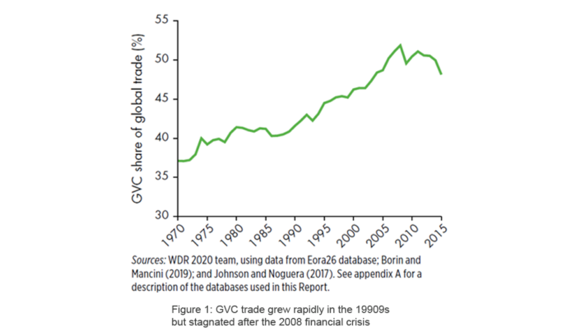
Today, more than half of global trade involve global value chains (GVCs)

Slide 28
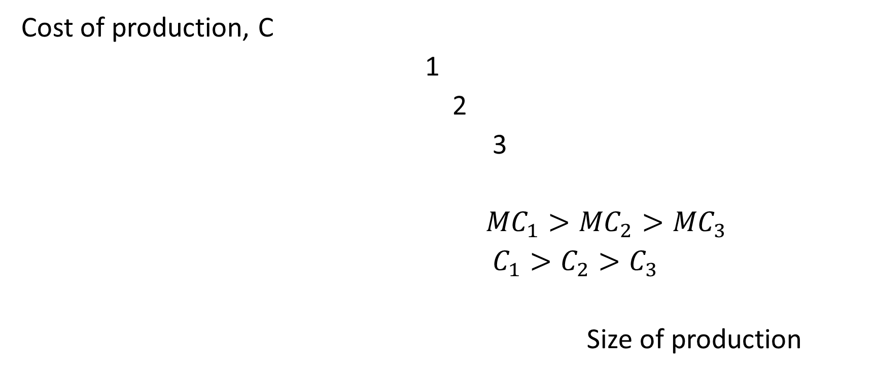
Why MNCs fragment their production value chains across countries?
Cost of production, C
1
2
3
${MC}_{1}>{MC}_{2}>{MC}_{3}$
$C_{1}>C_{2}>C_{3}$
Size of production

Slide 29
In conclusion
MC vs MB is the analytical tool for economists to think through problems and solutions in wide-ranging issues from production to market transactions, pollutions and even vaccination, you name it.
In next hour, we proceed to the analysis of supply and demand – the widely-used application of MC and MB.

Slide 30
Lesson III:
Supply and demand

Slide 31
Supply of a goods or services occurs when price is at least as high as marginal cost, P≥MC
Price
Supply (a short-run MC)
P’>MC
P’=MC’
P=MC
Quantity

Slide 32
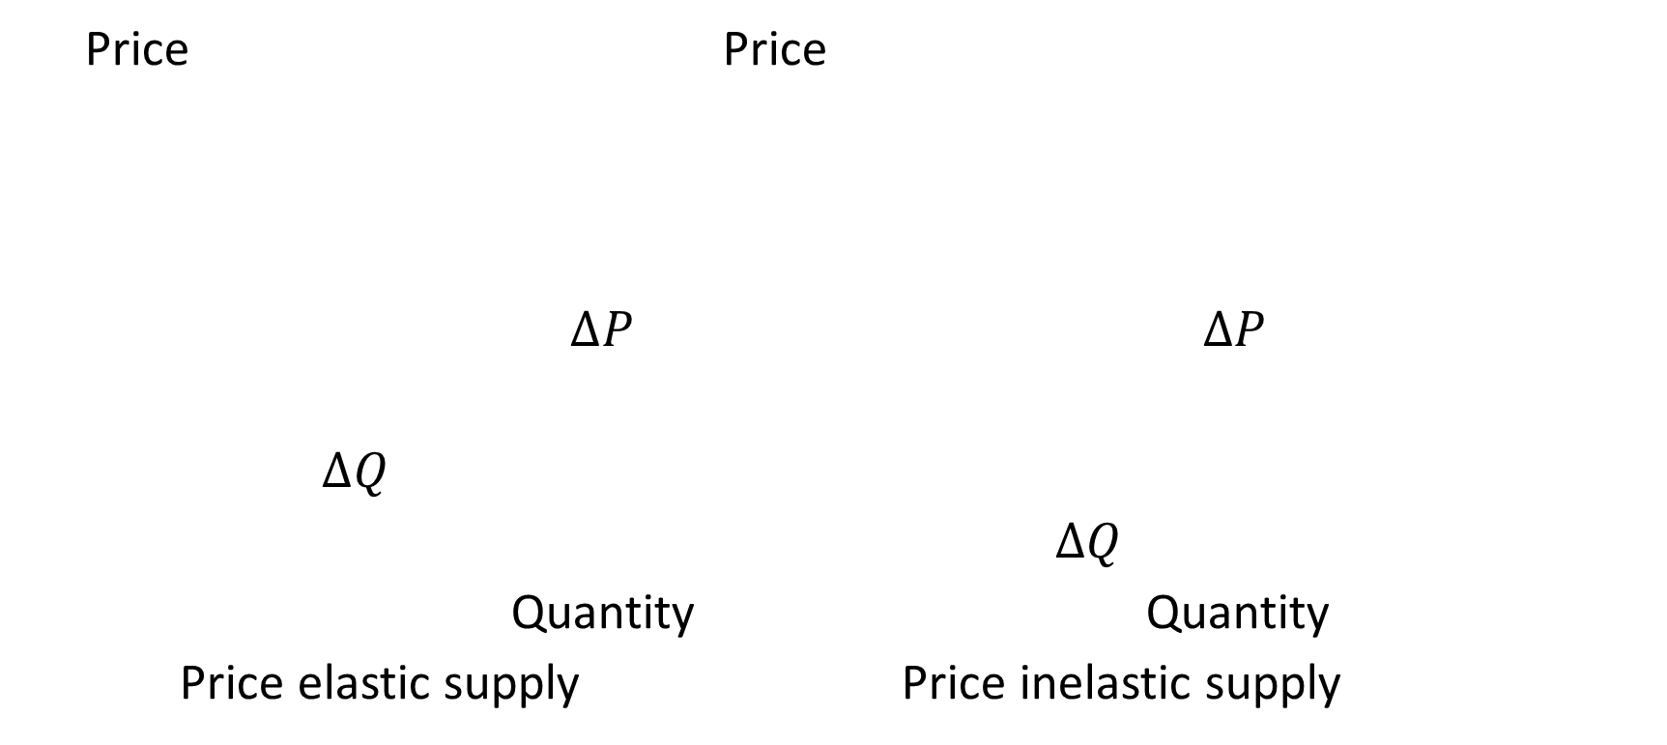
Price elasticity of supply is an important concept. Some supplies are sensitive to price changes, some are not
Price Price
$∆P$ $∆P$
$∆Q$
$∆Q$
Quantity Quantity
Price elastic supply Price inelastic supply

Slide 33
Demand occurs when price is at least as low as the marginal benefit. People buy more whenever P≤MB
Price
P’>MB
P=MB
P”<MB
D
Quantity

Slide 34
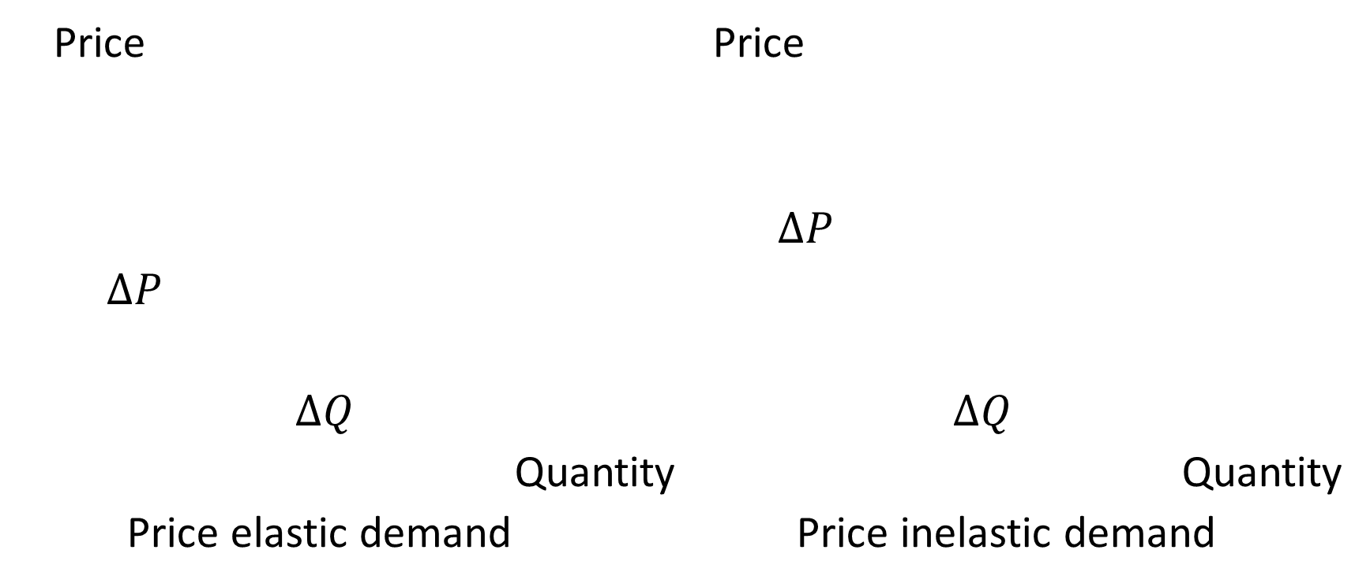
Not every purchase is sensitive to price change.
Price Price
$∆P$
$∆P$
$∆Q$ $∆Q$
Quantity Quantity
Price elastic demand Price inelastic demand

Slide 35
Market equilibrium
Price
D S
Quantity

Slide 36
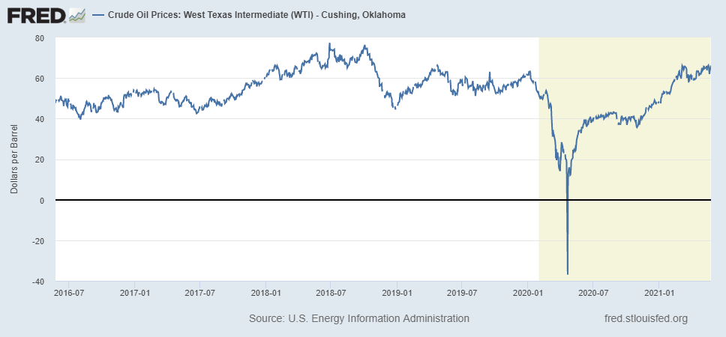
Why commodity prices nosedive in last April but skyrocket since then?

Slide 37
It was the demand crash, followed by demand recovery and supply restraint
Crude oil price
S
D
D’
Q

Slide 38
Government keeps raising sin tax not just because cigarettes are sinful
i) it is a good source of tax revenue (A+B),
ii) companies can still make profit(A>C), and
iii) consumers bearing most of the tax burden are discouraged from smoking (A>B)
Price/tax
S’
S
A
Tax
B
C
D
Q

Slide 39
Price your product/service higher sometimes can boost your sales revenue
Overall revenue falls as higher prices fail to compensation drops in sales.
But story is different when products are price inelastic
Price
S
S’
D(elastic)
D(inelastic)
Quantity

Slide 40
In conclusion
People react to incentive.
Whenever the price to pay for a product/service is lower than the benefit obtained, demand for the product will be greater.
But it doesn’t mean that demand will be increasing forever! Why?
When selling price is higher than the marginal cost, firms respond by supplying more to reap the profit until price equals marginal cost.
But firms also react to average cost. Why?
For that, in next hour, we’re introduced the concept of diminishing marginal return and increasing return to scale.

Slide 41
Lesson IV:
Diminishing marginal return vs. increasing return to scale

Slide 42
Diminishing marginal return is everywhere
Eating is satisfying, but satisfaction will be getting smaller the more you eat because you can get full
Boss certainly hopes that employees can work longer, as longer hours he work, more tasks he can complete. But the reality is what he can achieve in the first hour of work is much greater than what he can complete in the last hour of work: people get exhausted (not to speak the quality of work)
What government spent on building road in 1970s contributes to the economic growth far more than the same billion ringgit spent today: the former starts from scratch, the latter means just another highway

Slide 43

Every input/resource/idea utilised in production and organisation, however brilliant, will face its limits
Output
Production function
$∆Q$
$∆Q$
Input

Slide 44
However satisfying a product is, appetite for it will peak and consumers are ready to try others
Good y
Indifference curve
y A (y>x)
y’ B(x’>y’)
Good x
x x’

Slide 45
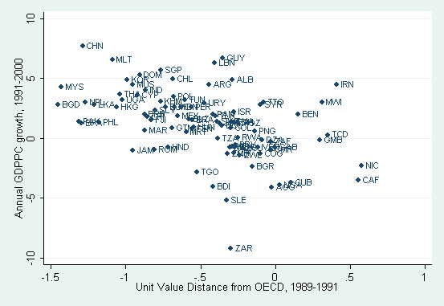
Global catching-up in export quality
Key takeaway from this figure: countries with lower quality in exports grow faster compared to those with already high export quality

Slide 46
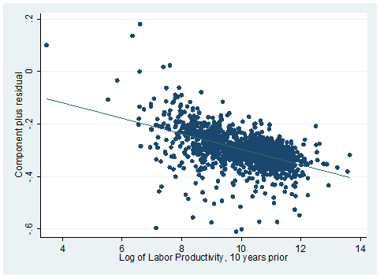
Global convergence in productivity growth
Countries with lower labour productivity to start with grow faster

Slide 47
Why average growth rates decline over the years of development? Diminishing marginal return!
GDP
Production function
Year
1960 1980 2010 2020

Slide 48
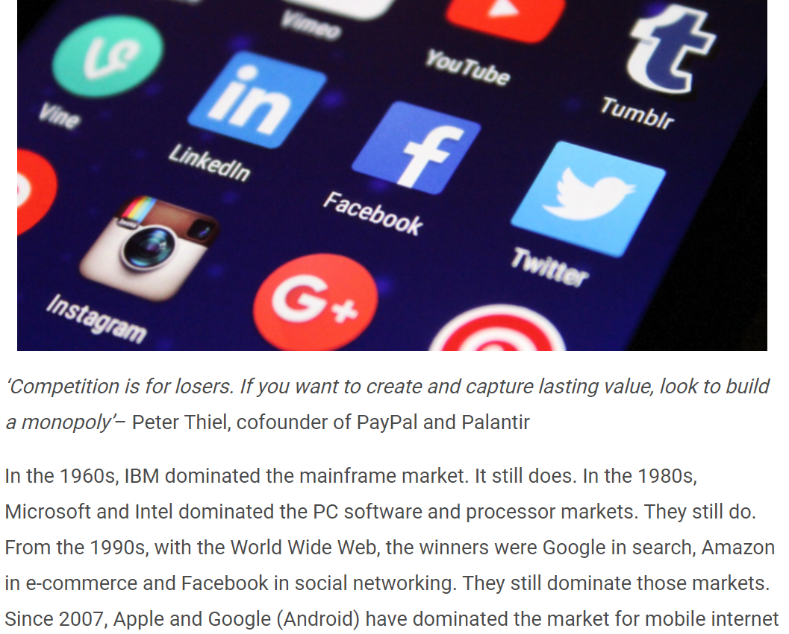

Slide 49
What’s in common for Microsoft, Intel, Google, Amazon, and Apple?
There is a huge sunk cost/fixed cost (i.e., R&D, infrastructure, apps development) for product/service development, but low and near to zero marginal cost to serve additional customer
Sunk, fixed cost is more important than marginal cost in making decision
Let’s use a simple algebra to understand the role of sunk, fixed cost and its implication

Slide 50
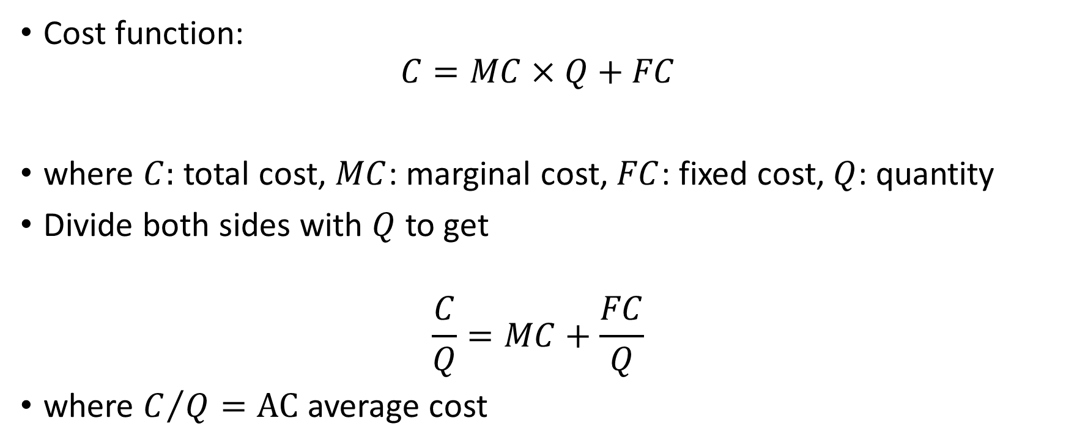
P = AC instead of P = MC
Cost function:
$$C=MC×Q+FC$$
where $C:$ total cost, $MC$: marginal cost, $FC$: fixed cost, $Q$: quantity
Divide both sides with $Q$ to get
$$\frac{C}{Q}=MC+\frac{FC}{Q}$$
where $C/Q=AC$ average cost

Slide 51

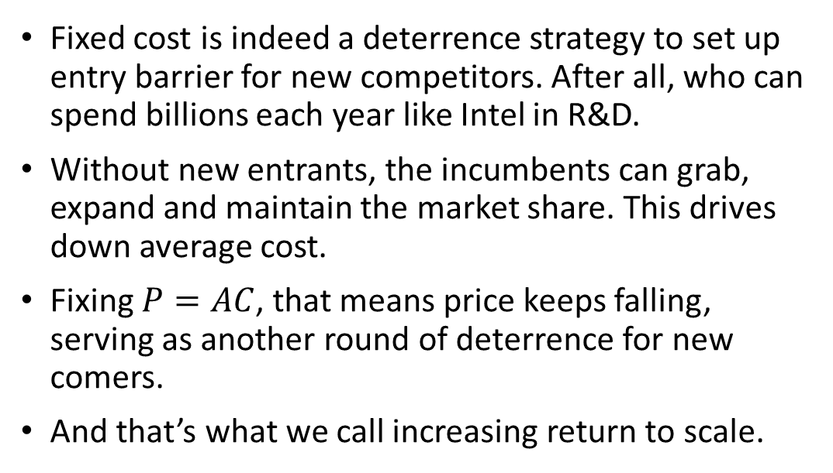
Business lesson: Increasing return to scale is the key to monopolising the market
Fixed cost is indeed a deterrence strategy to set up entry barrier for new competitors. After all, who can spend billions each year like Intel in R&D.
Without new entrants, the incumbents can grab, expand and maintain the market share. This drives down average cost.
Fixing $P=AC$, that means price keeps falling, serving as another round of deterrence for new comers.
And that’s what we call increasing return to scale.

Slide 52
Lesson V:
Externalities

Slide 53
What is externality?
A market transaction typically involves a set of buyers and sellers. Whatever they have done, it is accounted for in the market price.
But sometimes the transactions/actions could affect other set of sellers or buyers not directly involved in it, and therefore is not accounted for in the market price.
And this is called externality.
Because price does not reflect the impact of an action/transaction on the third party, it doesn’t reflect the true cost and benefit.

Slide 54
Positive externality
When firms and individuals do no take into account the benefits to the society associated with positive externalities, the result is under production and consumption, and the forgone social benefit.
Marginal social benefit (MSB) therefore consists of the marginal private benefit and marginal external benefit

Slide 55
No one is safe until everyone is safe
Vaccines provide a good example of positive externality.
Unlike being caught flu, which has very low transmittivity and fatality, being infected the coronavirus is no longer about yourself: you can be a super spreader that transmit the virus to many people.
Even when to you it turned out to be just an ordinary flu, it can be deadly for the people being infected by you.
Therefore, whether to pay for taking a vaccine is not just a matter of private transaction, it has social consequence.

Slide 56
Why vaccine is FOC? Why vaccination shall be encouraged for whatever it takes?
Government can do something to move MB closer to marginal social benefit (MSB)/make price reflect MSB: convenience, consolation, compassion
Value
MSB
MB
MC
Vaccination
Herd immunity
But apparently it is not enough to reach herd immunity, unless vaccine is free (MC=0)

Slide 57
Negative externality
Because externalities are not reflected in market prices, they can be a source of economic inefficiency.
When firms and individuals do no take into account the harms associated with negative externalities, the result is excess production and consumption, and unnecessary social cost.
Marginal social cost (MSC) therefore consists of the marginal private cost (MC) and marginal external cost (MEC).

Slide 58
Why people dispose scrap materials easily? How to change the situation?
People dispose scrap because it is nearly costless. But it brings massive marginal social cost (MSC). The cost of disposal doesn’t reflect this SMC.
Cost
MSC
MCR
MC
0 Scrap
Recycling
Solution is to get MC closer to SMC/make price to pay reflect SMC: refundable deposit

Slide 59
Or a mix of policy: refundable deposit with subsidies to make marginal cost of recycling cheaper
Cost
SMC
MCR
MCR’
MC
0 Scrap
Recycling

Slide 60
Put a price on carbon emission to fight climate change
Carbon emission is excessive because it is FOC. To capture MEC, carbon as an input must be priced via carbon tax. How much to tax depends on nation’s capacity to abate emission (MCA)
Price of emission
MCA
MEC
Carbon tax
0 Level of emission

Slide 61
Tax revenue can be used to subsidise abatement technology, reducing emission and the need for tax
Price of emission
MCA
MEC
Tax
0 Level of emission

Slide 62
Lesson VI: Informational asymmetries

Slide 63
Information is usually asymmetric
A seller of a product knows more about its quality than the buyer does
Workers know their own skills and abilities better than employers
Business managers know more about their firms’ SWOT than do the firms’ owners
Borrowers know exactly the situation of the companies and what they’re going to do with the money borrowed than creditors do

Slide 64
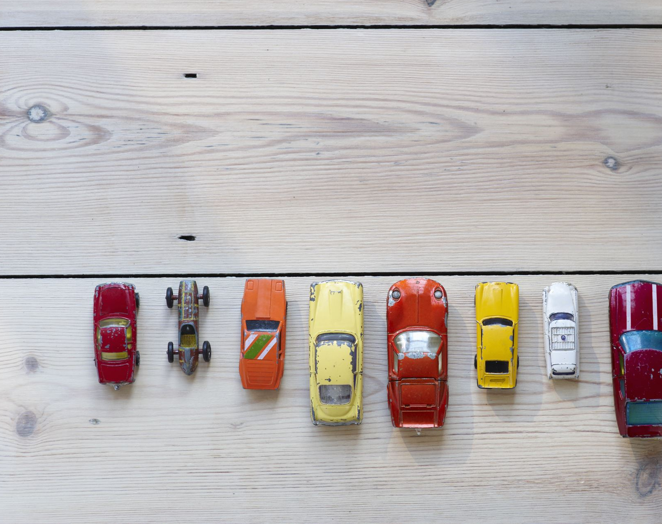
If informational asymmetries are severe…
Take used car as an example.
Suppose there are two types of used cars in the market: “lemons” and “apple”. Owners of the lemons would be happy if the car can be sold for $2000, where owners of the apple are not willing to sell their nice used car for less than $10,000
No car owners will admit theirs as the lemons in the market. Everyone wants to be, or pretend to be the apple.

Slide 65


… market will crash
That means information about the quality of the used car is asymmetric: sellers know more than buyers do
A buyer has a 50:50 chance of buying a lemon or an apple.
Therefore he must have a reservation price is his mind:
Reservation price
= Probability of buying lemons $×$ price of lemons
+
Probability of buying apple $×$ price of apple

Slide 66

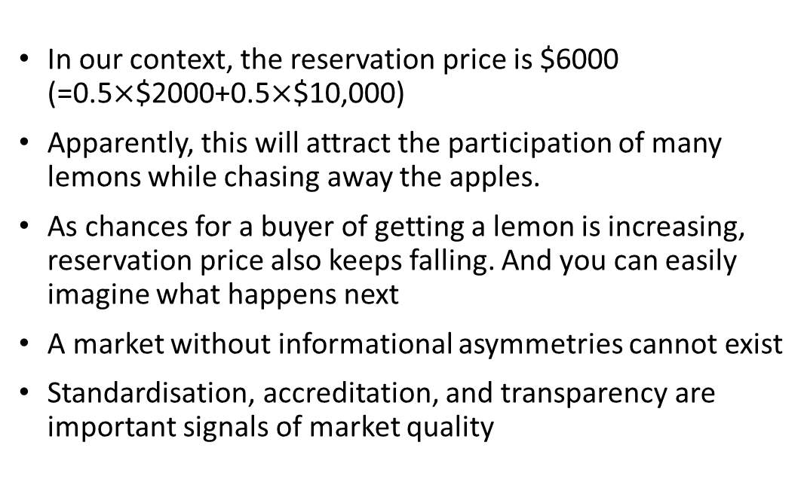
Symmetric information is the key to unlock a market
In our context, the reservation price is $6000 (=0.5$×$$2000+0.5$×$$10,000)
Apparently, this will attract the participation of many lemons while chasing away the apples.
As chances for a buyer of getting a lemon is increasing, reservation price also keeps falling. And you can easily imagine what happens next
A market without informational asymmetries cannot exist
Standardisation, accreditation, and transparency are important signals of market quality

Slide 67
Why higher and rising interest rate do not necessarily at banks’ benefit?
It seems to be a common sense that low interest rate environment is bad for banks, as low interest rate means low revenue from lending business. Logically, increasing interest rate must be good for banks’ business.
Not always, if we consider adverse selection

Slide 68
Pool of willing borrowers at a high interest rate shifts adversely
As the probability of default rises, a lender will require a higher interest rate to compensate for the risk.
But higher interest rates attract borrowers who are worse risks

Slide 69

Individuals are willing to borrow at high interest rate because they perceive their probability of repaying the loan to be low
Suppose $r=2\%$, probability of default $ρ=0$,
Expected return = $ρ×0\%+\left(1−ρ\right)×2\%=2\%$
If $r=12\%$ with $ρ=0.5$, then expected return = $6\%$

Slide 70
Informational asymmetries occur also in decentralised finance

Slide 71
Lesson VII: Internal and external balances

Slide 72
Malaysia was celebrated as one of 13 success stories of sustained, high growth (Growth Report, 2008)

Slide 73
For 6 decades, Malaysia enjoys sustained, high growth. From business cycle point of view, that’s awesome. From structural transformation point of view, we observe structural growth slowdown

Slide 74
Same holds true when growth rates were categorised based on big events. The sudden structural growth slowdown is even more obvious

Slide 75
I>S before AFC, but S>I since then, signaling internal surplus or insufficient aggregate demand post-AFC. Demand Recovery in past years seems to be debt-fueled consumption driven than investment-driven

Slide 76
Budget deficit is more like a norm than an exception. There was a short period of surplus in 1990s but structural deficits the remaining years

Slide 77
Two points stand out: i) trade surplus was huge post-AFC, but getting smaller post-GFC ii) Export & import capacity is shrinking

Slide 78

Private sector surplus, budget deficit and trade surplus: Are they linked?
Yes, they are!
Think of two-sector economy (domestic private and public sectors)
Households consume $C$, save $S$ and pay tax $T$:
$$Y=C+S+T$$
Firms invest $I$, government spends $G$, So in equilibrium, GDP looks like
$$Y=C+I+G$$

Slide 79

Budget deficit is the mirror image of private aggregate demand deficiency
Bringing in households’ budget constraint,
$$Y−C=I+G⇒$$
$$S+T=I+G$$
Rearranging it, we learn that budget deficit mirrors insufficient private aggregate demand
$$S−I=G−T$$

Slide 80
Instead of worrying budget deficit, a more critical question is why private sector is in surplus for decades? What’re the consequences?

Slide 81

Trade surplus is a sign of weakness not strength
Think of a three-sector economy now: private domestic, public and external (exporting $X$ and importing $M$ sector)
$$Y=C+I+G+X−M$$
Bringing in households budget constraint,
$$S−I+T−G=X−M$$

Slide 82
From macroeconomic point of view, trade surplus is not a reason of joy

Slide 83
In conclusion
External balance usually reflects internal balance
Government budget can’t turn surplus while trade is in surplus for years because the underlying issue is weak private investment
Two more macroeconomic issues spotted: declining exporting and importing capacity and dissaving
And they are linked.

Slide 84
Lesson VIII: Money supply and inflation

Slide 85
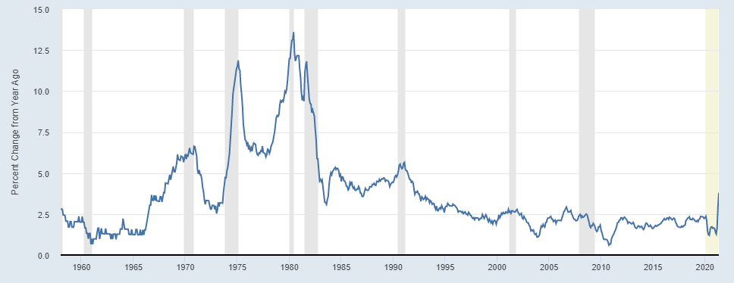
“Inflation is baaaaack!” Really?

Slide 86
So does the circumstance for Malaysia

Slide 87
Two observations and two questions about 2021 inflationary concern
#1 Inflation didn’t fall as drastic as those in the past recessions
#2 But it bounces back faster than those during the economic recovery
This has to do with the nature of the pandemic crisis
Of questions are
#1 is it transitory?
#2 Does ultra-loose monetary policy cause inflation?

Slide 88
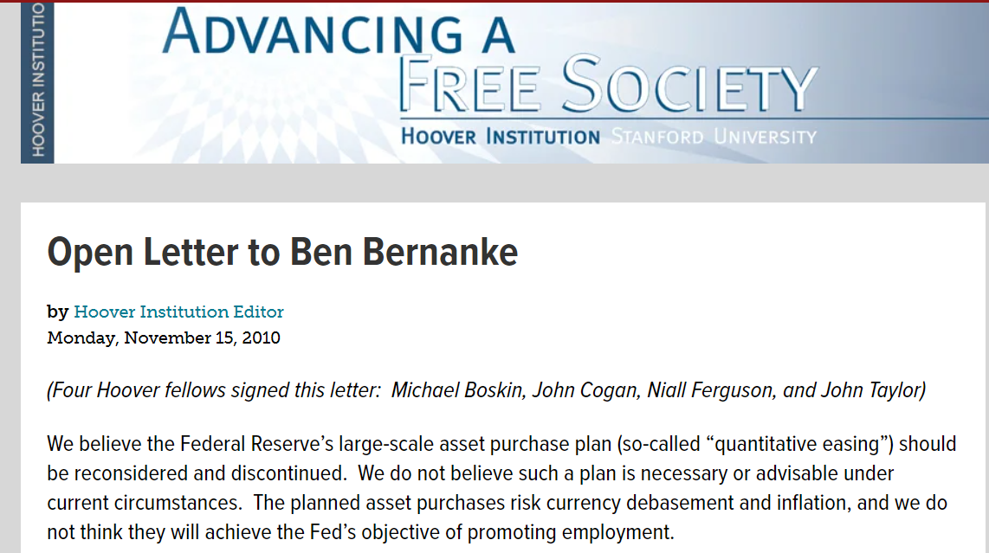
Warning for inflation is not new.
What’re the driving forces?

Slide 89
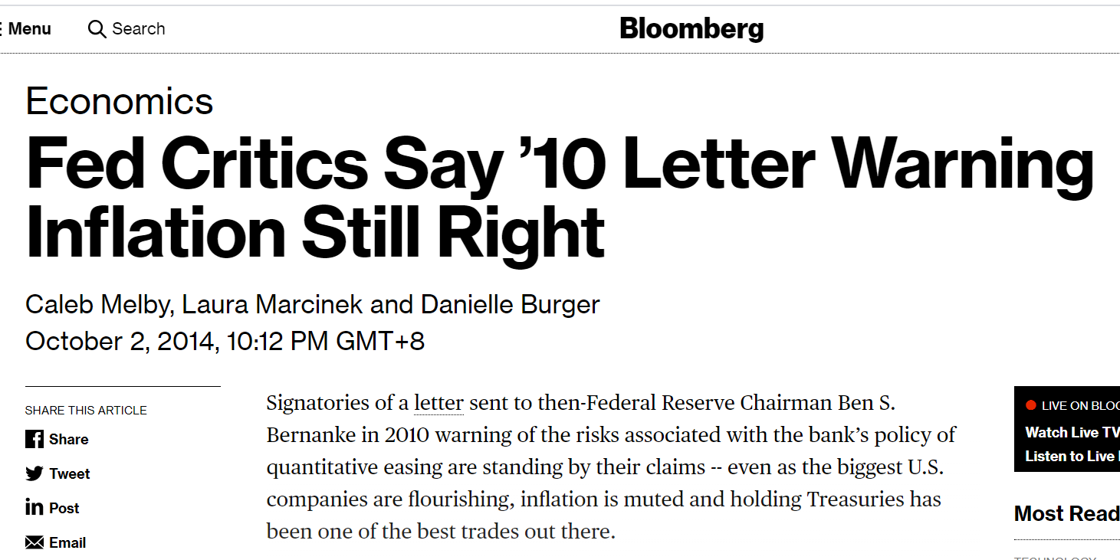
Explanation 1: QE causes inflation

Slide 90
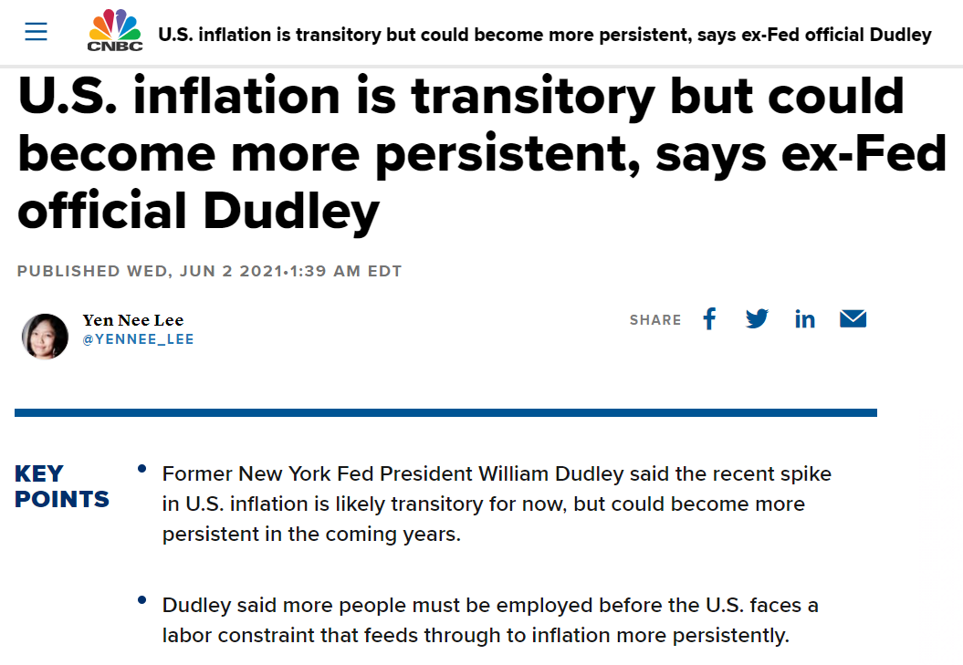
Explanation 2: Supply side (especially labour participation) needs time to recover

Slide 91
For previous crises and recessions, they were mainly aggregate demand shocks
Price level
AS (Aggregate supply)
AD’
AD (Aggregate demand)
GDP

Slide 92
Pandemic crisis is both supply and demand shocks
Price level AS’ AS (Aggregate supply)
AD’
AD (Aggregate demand)
GDP
This explains why economic plunge is much severe while inflation decline is not during the pandemic.

Slide 93
When the economy recovers from AD-driven crisis, inflation typically bounces back to where it was
Price level
AS (Aggregate supply)
AD’
AD (Aggregate demand)
GDP

Slide 94
But if AD recovers faster than what the businesses can cope for post-pandemic, inflation goes higher while the economy is yet to fully recover
Price level
AS’ AS (Aggregate supply)
AD’
AD (Aggregate demand)
GDP
Rising inflation tends to transitory. And such inflation may not be necessarily bad, as it helps improve firms and workers’ balance sheets

Slide 95
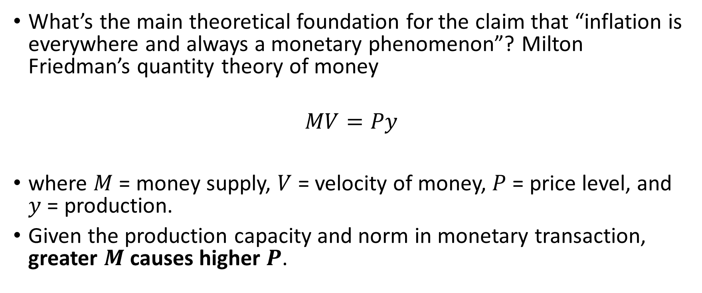
Back to the question: does (will) massive QE cause inflation?
What’s the main theoretical foundation for the claim that “inflation is everywhere and always a monetary phenomenon”? Milton Friedman’s quantity theory of money
$$MV=Py$$
where $M$ = money supply, $V$ = velocity of money, $P$ = price level, and $y$ = production.
Given the production capacity and norm in monetary transaction, greater $M$ causes higher $P$.

Slide 96
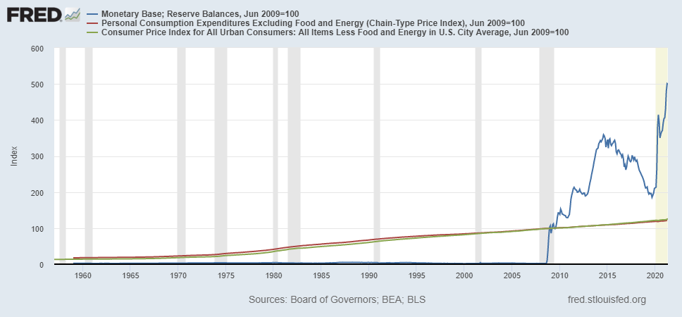
But apparently QE is not everywhere and always a villain for inflation

Slide 97
Monetary operating system does matter
Central bank balance sheet before large scale asset purchase
Central bank balance sheet after LSAP
Asset |  | Liabilities
Treasury bonds | 1000 | Excess reserves | 500
 |  | Currency | 500
Asset |  | Liabilities
Treasury bonds | 1000 1800 | Excess reserves | 500 1300
 |  | Currency | 500
Banks’ balance sheet before large scale asset purchase
Banks’ balance sheet before LASP
Asset |  | Liabilities
Loans | 1000 | Deposits | 2500
Excess reserves | 500
Treasury bonds | 1000
Asset |  | Liabilities
Loans | 1000 | Deposits | 2500
Excess reserves | 500 1300
Treasury bonds | 1000 200

Slide 98
If central bank pays no interest on reserves, banks will find ways to make loans from excess reserves
Asset |  | Liabilities
Loans | 1000 1800 | Deposits | 2500
Excess reserves | 500 1300 500
Treasury bonds | 1000 200
This is when QE will cause inflation

Slide 99
But Federal Reserves pay interest on reserves, banks are more than happy to keep the excess reserves
Asset |  | Liabilities
Loans | 1000 | Deposits | 2500
Excess reserves | 500 1300
Treasury bonds | 1000 200
This is when QE will have no impact on inflation

Slide 100
Lesson IX: Natural rate of interest

Slide 101
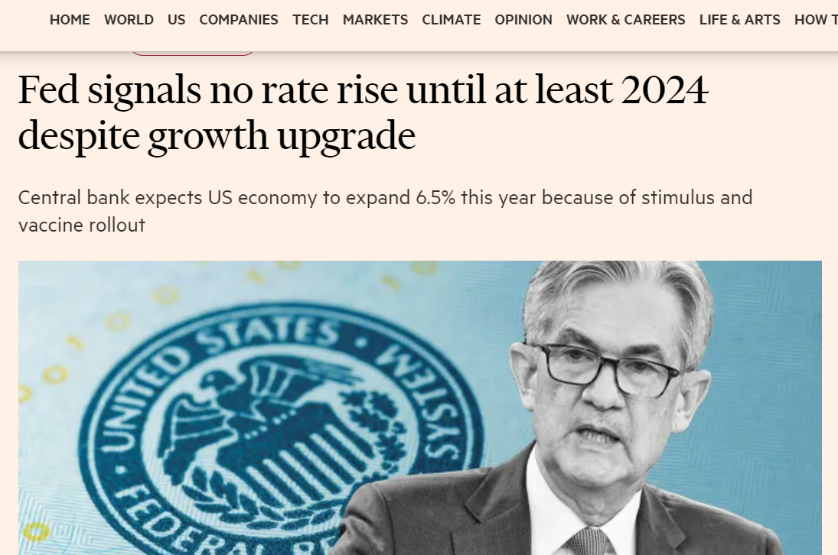
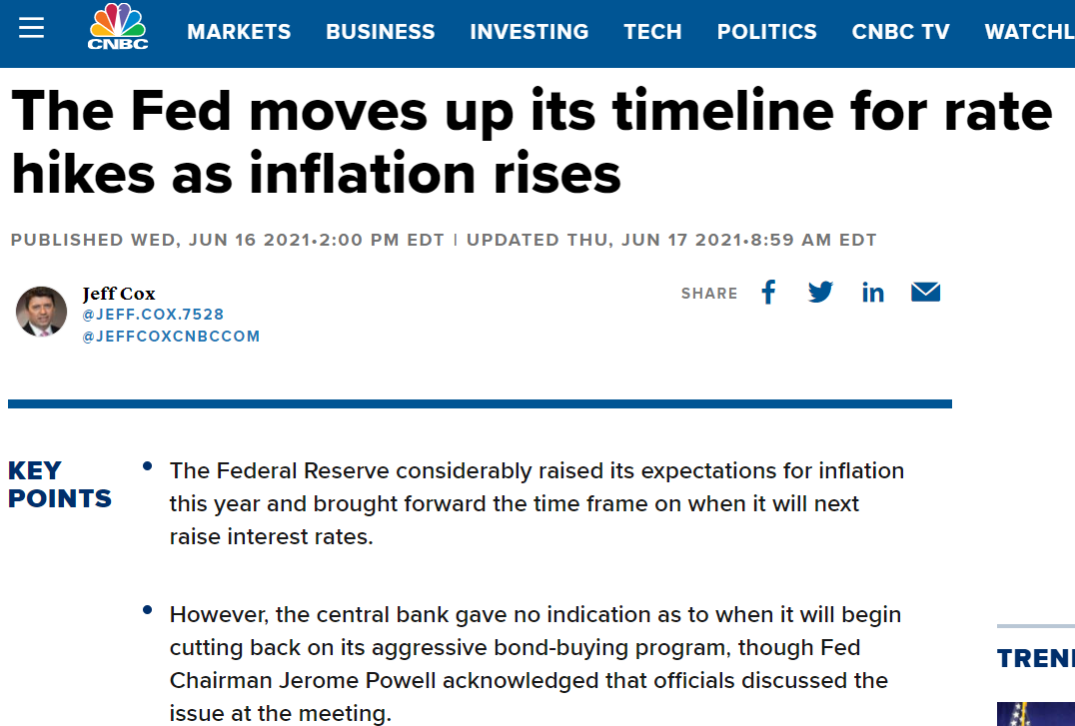
What determines when to raise interest?
By how much?

Slide 102
Phillips curve perhaps gives a guide: lower interest rate when unemployment is high and inflation is low, and vice versa

Slide 103
But sometimes it may not be that straightforward and explicit, especially when both unemployment and inflation are low or high simultaneously

Slide 104
When Phillips curve is vertical (meaning unemployment is unvarying with inflation), interest rate may not even need to respond to inflation variation

Slide 105
This holds truer post-GFC and pre-pandemic

Slide 106
What observations can you make out of Malaysia’s past 14 years of experience?

Slide 107
The first two are obvious, the next two are not, but important
#1: BNM lowers OPR twice during the crises and recession
#2: BNM normalises OPR when the economy is recovering
#3: When OPR is raised to a “certain level”, it will be maintained irrespective of the inflation rate
#4: That “certain level” seems to be getting lower in the new business cycle

Slide 108
And that “certain level” is called natural rate of interest
Real policy interest rate consistent with the economy operating at its full potential once transitory shocks to aggregate supply or demand have abated (Williams 2003)
A theoretical policy rate at which the stance of monetary policy is neither accommodative nor restrictive. It is the short-term real interest rate consistent with the economy maintaining full employment with price stability (Kaplan, 2018)

Slide 109
Knut Wicksell (1896)/Woodford (2003)
Natural rate is
The rate of interest that equates saving with investment
The marginal productivity of capital
The rate of interest that is consistent with aggregate price stability
It can be influenced by fiscal policy, productivity, technological change and demographics

Slide 110

r vs. r*
Think of Fisher equation:
$$i=r+π^{e}⇒r=i−π^{e}$$
where $i$ denotes policy rate, $r$ inflation-adjusted rate, and $π^{e}$ expected inflation
If $r>r^{∗}$, monetary policy is too restrictive, hurting the economy
If $r<r^{∗},$ monetary policy is too accommodative, creating inflation pressure

Slide 111
Natural interest rate that equilibrates S & I
interest rate
I S
r*
Funds

Slide 112
I drops significantly post-AFC, and S declines also recently. What it means for r*?

Slide 113
r* has been low for decades
interest rate
I S
S’
r*
r*’
I’
Funds

Slide 114
And low r* becomes a policy constraint
If zero lower bound limits how low an interest rate can be, r* constrains how high a policy interest rate can go
In other words, it limits policy space available for the next crisis
How to push up the r* (i.e., bolstering technological adoption and investment demand, increasing productivity) is an important policy issue

Slide 115
Lesson X: Expectation hypothesis

Slide 116
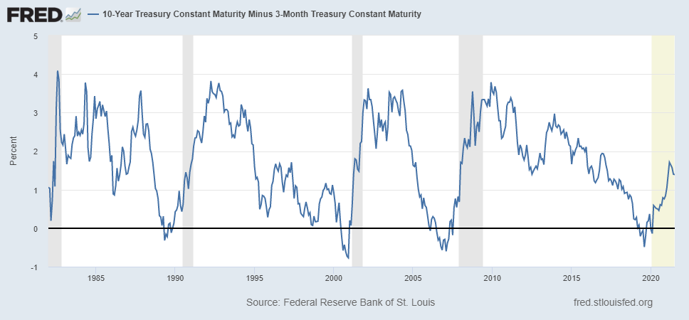
This was one of the most discussed figures during the US-China trade war year: yield curve has predicted a recession

Slide 117
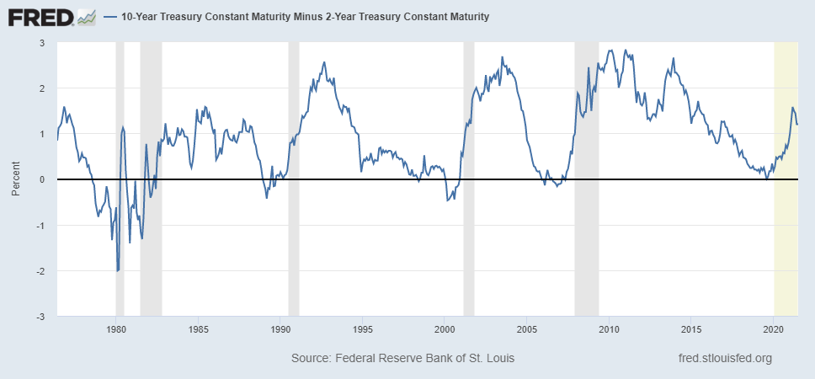
Positive values may imply future growth, negative values (declining positive values) may imply economic downturns

Slide 118
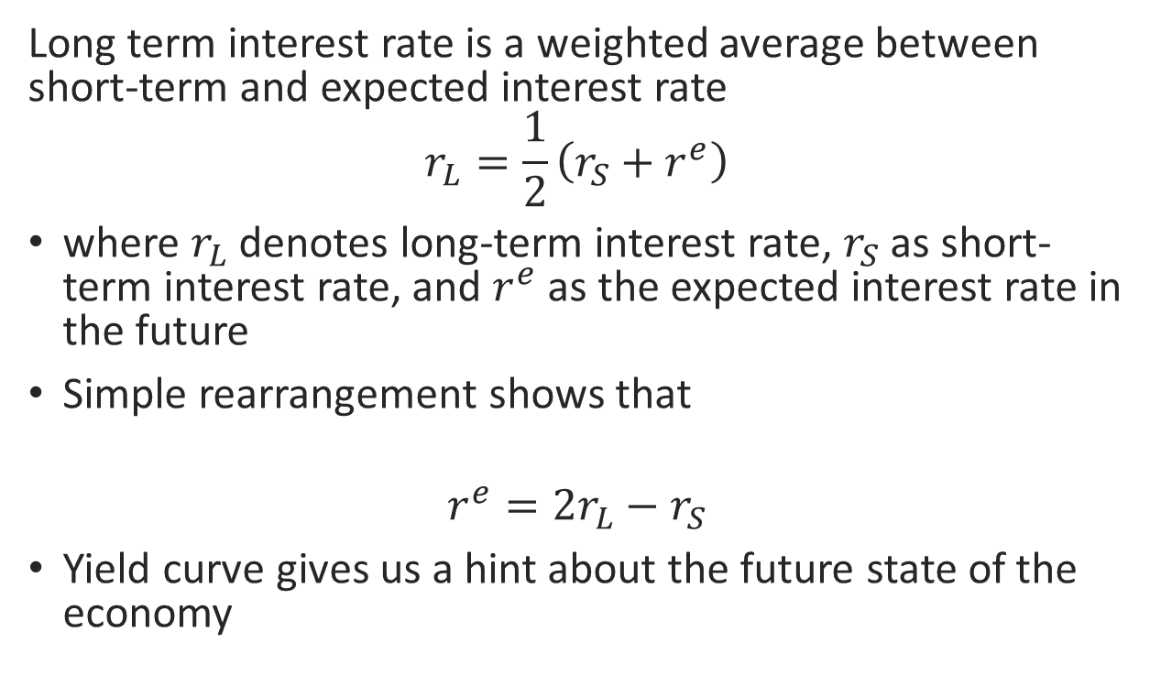
Expectation hypothesis
Long term interest rate is a weighted average between short-term and expected interest rate
$$r_{L}=\frac{1}{2}\left(r_{S}+r^{e}\right)$$
where $r_{L}$ denotes long-term interest rate, $r_{S}$ as short-term interest rate, and $r^{e}$ as the expected interest rate in the future
Simple rearrangement shows that
$$r^{e}=2r_{L}−r_{S}$$
Yield curve gives us a hint about the future state of the economy

Slide 119
Yield curve and the state of the economy
If the economy is expected to recover (i.e, inflation rate starts increasing, stock index rising), the market would expect interest rate to go up in the future (i.e, to compensate for inflation risk, and as a result of portfolio reshuffling between bonds and stocks)
And you can easily imagine the otherwise

Slide 120
Does yield curve work in Malaysia?

Slide 121
Yield curve has a reasonably well explanatory power on inflation

Slide 122
So does its explanatory power on stock price changes

Slide 123
The next interesting question then is: what explains yield curve? Monetary policy & market expectations

Slide 124
Lesson XI: Government debt

Slide 125
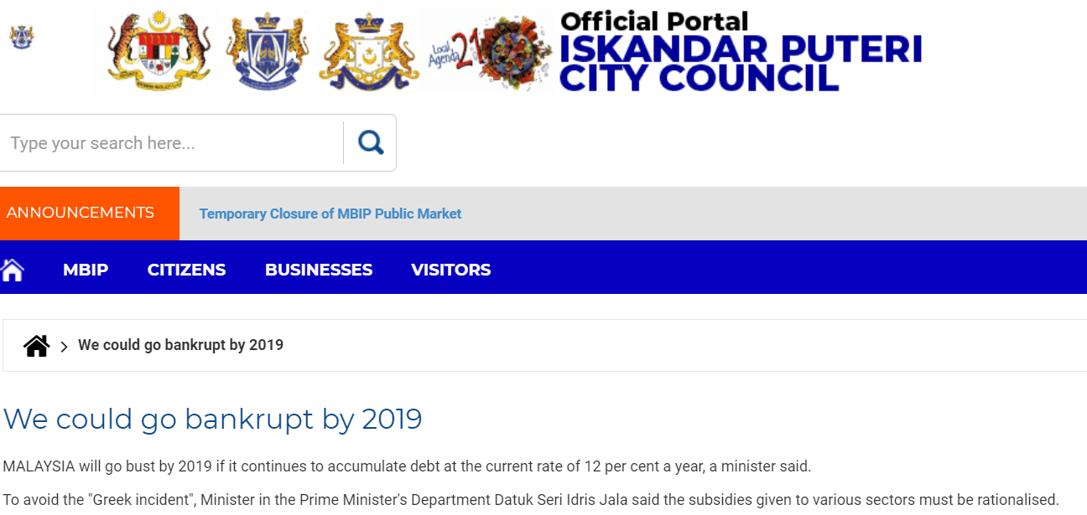
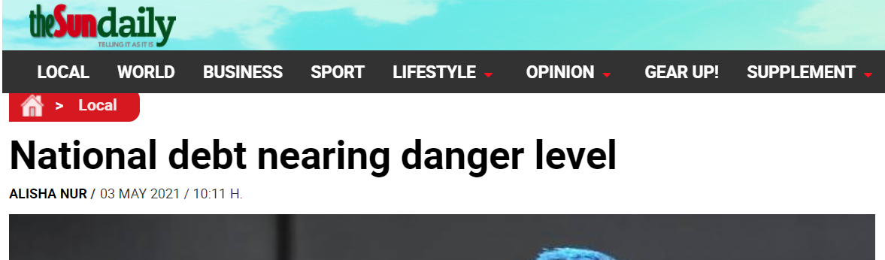
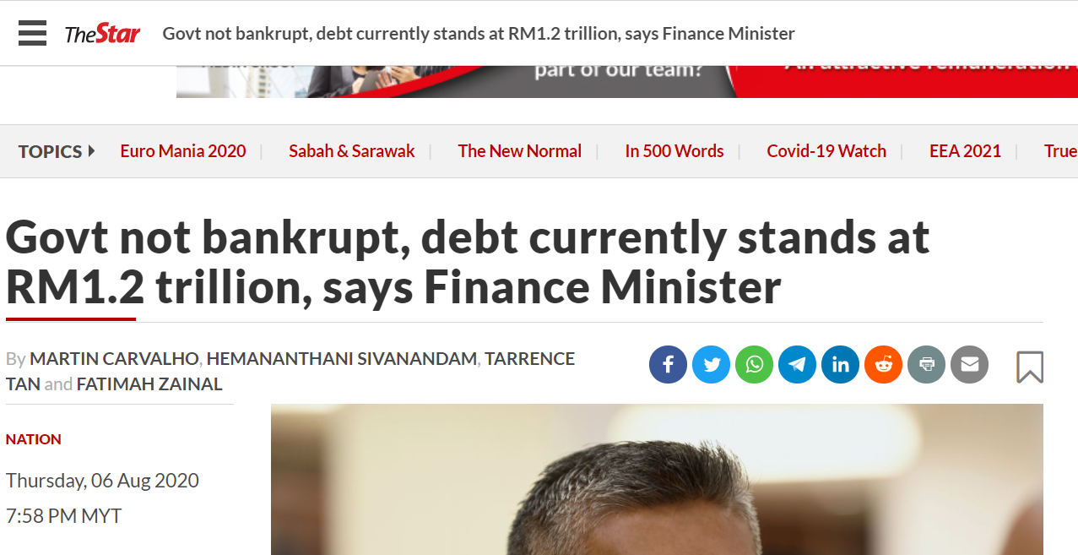

Slide 126
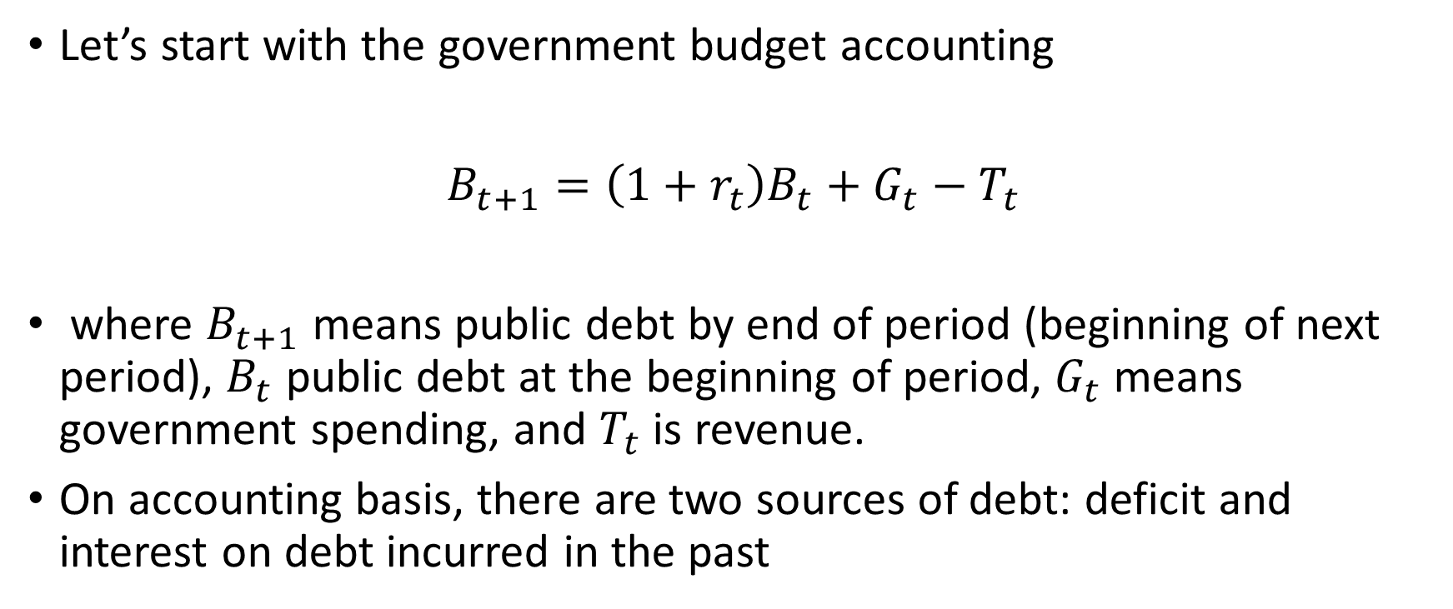
Is Malaysian government too indebted and going to bankrupt?
Let’s start with the government budget accounting
$B_{t+1}=\left(1+r_{t}\right)B_{t}+$ $G_{t}−T_{t}$
where $B_{t+1}$ means public debt by end of period (beginning of next period), $B_{t}$ public debt at the beginning of period, $G_{t}$ means government spending, and $T_{t}$ is revenue.
On accounting basis, there are two sources of debt: deficit and interest on debt incurred in the past

Slide 127
What’s the narrative we usually hear? We’re going to bankrupt as this year’s budget deficit is so huge
But we’ve been in deficits for decades! And yet, S&P Global Ratings still affirmed A- for long-term sovereign credit in Malaysia in June 2021

Slide 128
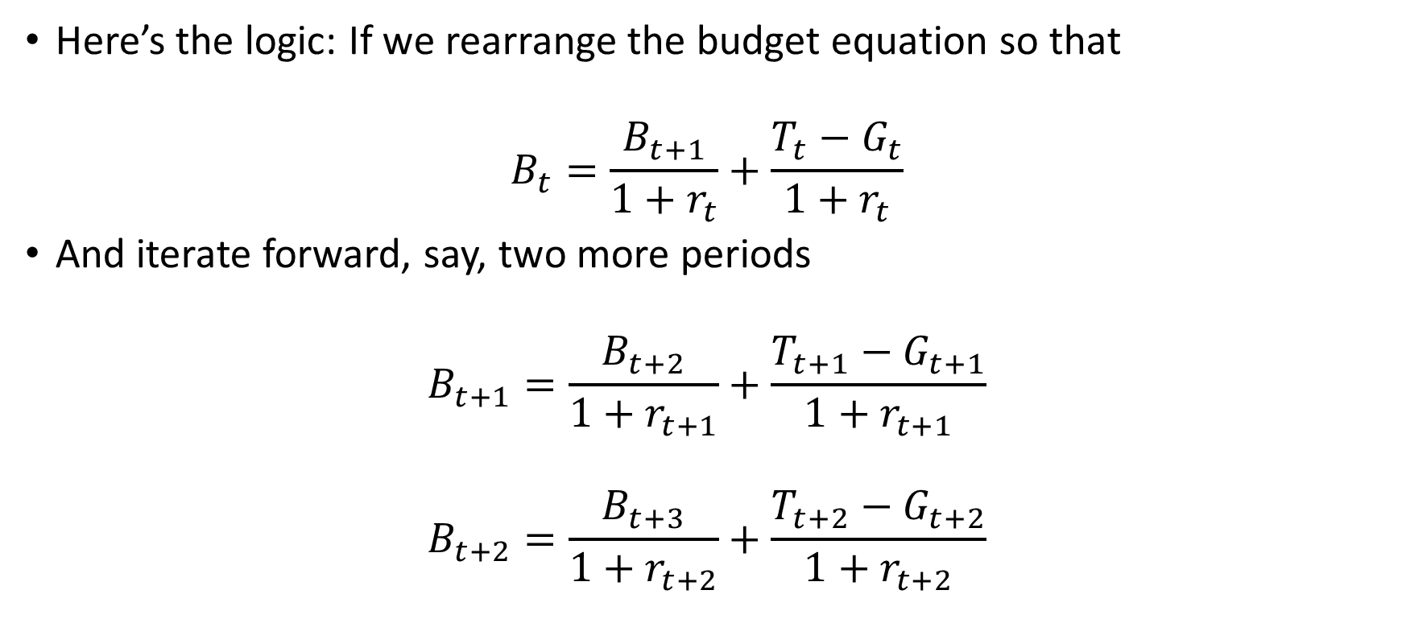
#1:What matters for debt sustainability is expected deficit over the long run, not a year’s budget
Here’s the logic: If we rearrange the budget equation so that
$$B_{t}=\frac{B_{t+1}}{1+r_{t}}+\frac{T_{t}−G_{t}}{1+r_{t}}$$
And iterate forward, say, two more periods
$$B_{t+1}=\frac{B_{t+2}}{1+r_{t+1}}+\frac{T_{t+1}−G_{t+1}}{1+r_{t+1}}$$
$$B_{t+2}=\frac{B_{t+3}}{1+r_{t+2}}+\frac{T_{t+2}−G_{t+2}}{1+r_{t+2}}$$

Slide 129
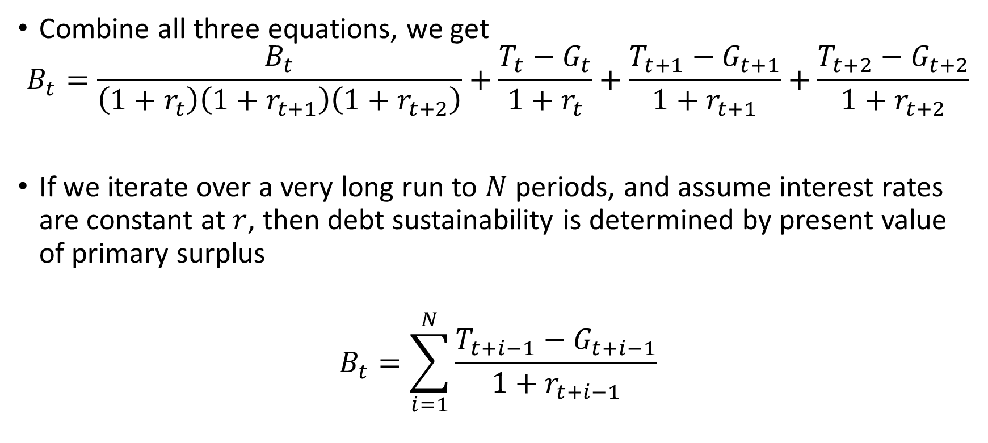
#1: As long as the market believes in fiscal discipline over (very) long run, debt is self-sustainable
Combine all three equations, we get
$$B_{t}=\frac{B_{t}}{\left(1+r_{t}\right)\left(1+r_{t+1}\right)\left(1+r_{t+2}\right)}+\frac{T_{t}−G_{t}}{1+r_{t}}+\frac{T_{t+1}−G_{t+1}}{1+r_{t+1}}+\frac{T_{t+2}−G_{t+2}}{1+r_{t+2}}$$
If we iterate over a very long run to $N$ periods, and assume interest rates are constant at $r$, then debt sustainability is determined by present value of primary surplus
$$B_{t}=\sum_{i=1}^{N}{\frac{T_{t+i−1}−G_{t+i−1}}{1+r_{t+i−1}}}$$

Slide 130
And the market did “show” confidence on Malaysia’s fiscal sustainability

Slide 131
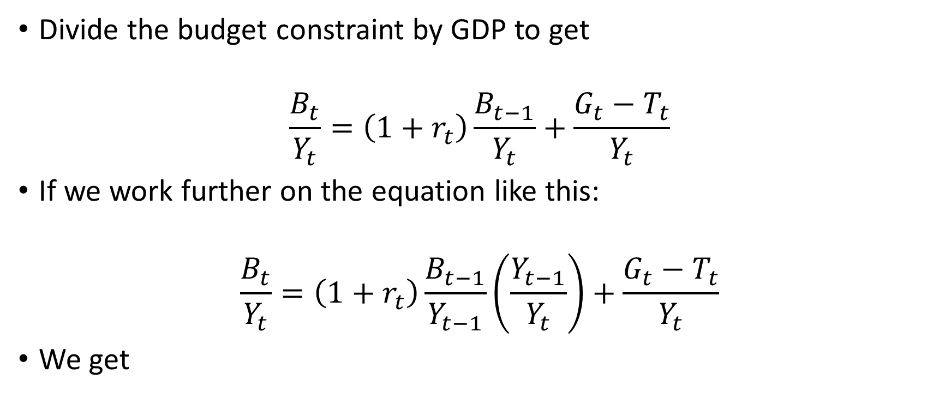
In economic analysis, we usually look into debt ratio instead of absolute debt value
Divide the budget constraint by GDP to get
$$\frac{B_{t}}{Y_{t}}=\left(1+r_{t}\right)\frac{B_{t−1}}{Y_{t}}+\frac{G_{t}−T_{t}}{Y_{t}}$$
If we work further on the equation like this:
$$\frac{B_{t}}{Y_{t}}=\left(1+r_{t}\right)\frac{B_{t−1}}{Y_{t−1}}\left(\frac{Y_{t−1}}{Y_{t}}\right)+\frac{G_{t}−T_{t}}{Y_{t}}$$
We get

Slide 132

#2: We can grow out of the debt ratio won’t be explosive and is sustainable if r<g
$$\frac{B_{t}}{Y_{t}}=\underset{<1}{\underbrace{\left(\frac{1+r_{t}}{1+g_{t}}\right)}}\frac{B_{t−1}}{Y_{t−1}}+\frac{G_{t}−T_{t}}{Y_{t}}$$
We can grow out of debt if $r<g$

Slide 133
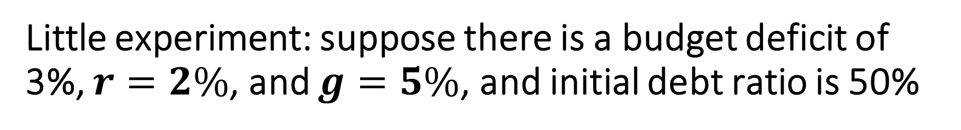
Little experiment: suppose there is a budget deficit of 3%, $r=2\%$, and $g=5\%$, and initial debt ratio is 50%

Slide 134
#2: r<g is a norm, indicating a sustainable debt ratio

Slide 135
#3: Government debt is long-term and ringgit-denominated

Slide 136
But it doesn’t mean everything is just alright!
Years of budget deficit indicates weak private sector investment
There is a long-term debt sustainability issue, especially on revenue side

Slide 137
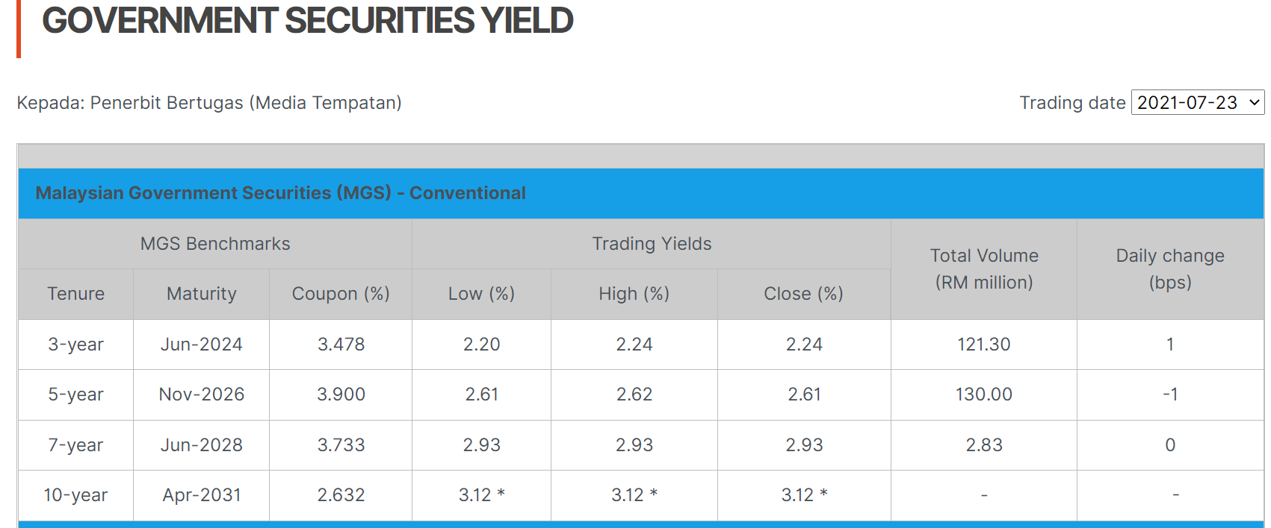
Long-term bonds are traded as discount bonds
which can indicate default expectation, reluctance to buy the debt

Slide 138
Low tax revenue ratio is a growing concern especially when the population is aging and raising income tax is politically and economically harder

Slide 139
Lesson XII: Safe assets

Slide 140
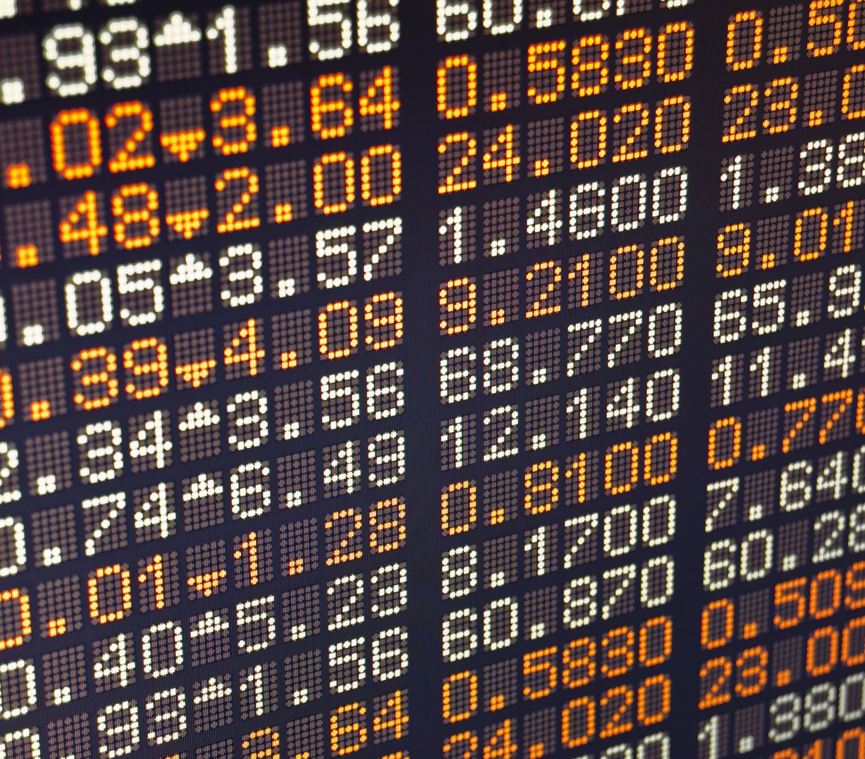
How an exchange rate is typically determined?
A currency turns weak if the economy is expected to slide, and if the central bank is expected to cut interest rate.
I use the word “expected” because for investors, exchange rates are just like any other asset prices, they buy on expectations and sell on news.
For instance, ringgit depreciates when interest rate is expected to be slashed. But when it comes to the day of policy announcement, ringgit would either barely move or appreciate, unless there is a surprise in the announcement (Remember how stock index reacts when PM announces resignation?)

Slide 141

Theory that informs us is uncovered interest parity condition
Denoting $S$ as spot exchange rate (i.e., RM/US$), $S^{e}$ $r$ as interest rate, and $r^{∗}$ as US interest rate, arbitrage condition enabled by unrestricted capital flows implies that return to ringgit asset shall be equivalent to return on dollar asset
$$1+r=\left(\frac{1+r^{∗}}{S}\right)S^{e}$$
Rearrange it we have
$$S=\left(\frac{1+r^{∗}}{1+r}\right)S^{e}$$

Slide 142
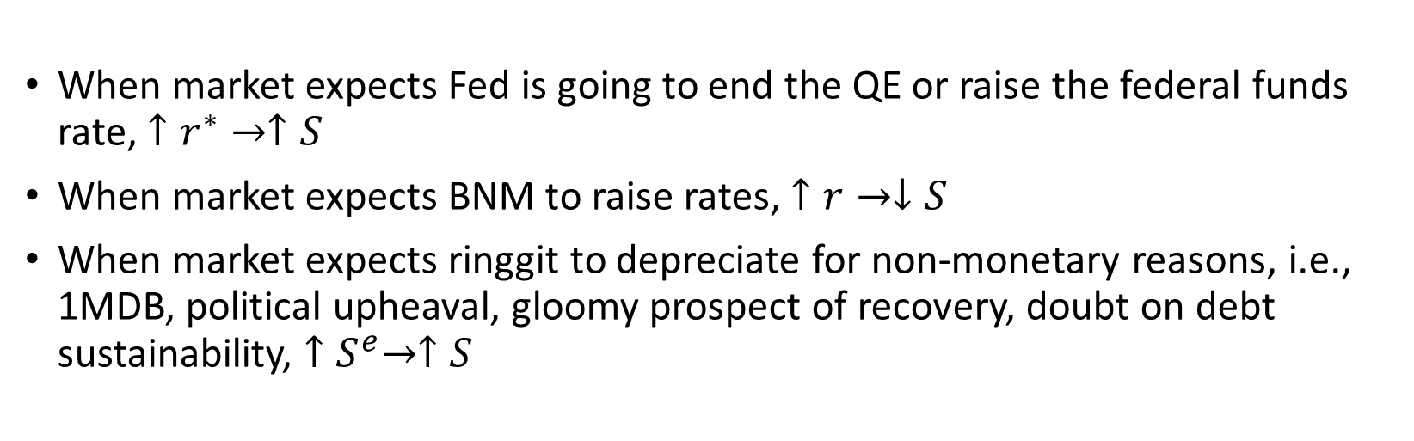

$$S=\left(\frac{1+r^{∗}}{1+r}\right)S^{e}$$
When market expects Fed is going to end the QE or raise the federal funds rate, $↑r^{∗}→↑S$
When market expects BNM to raise rates, $↑r→↓S$
When market expects ringgit to depreciate for non-monetary reasons, i.e., 1MDB, political upheaval, gloomy prospect of recovery, doubt on debt sustainability, ${↑S}^{e}→↑S$

Slide 143
Generally the theory works, though not all the time

Slide 144
There are times when it works the other way round: currency depreciates, and interest rate cuts follow

Slide 145

And those are the time when uncertainty elevates, triggering risk-off capital flows back to the U.S

Slide 146

This has to do with the U.S treasury assets being the safe assets
$$S=\left(\frac{1+r^{∗}}{1+r}\right)S^{e}+risk premium$$
Whenever the world economy turns more unstable, risk-off strategy is kicking in, one would see a reversal of capital flowing back to the world’s deepest and most liquid financial market,
$↑risk premium→↑S$
When the prospect turns brighter with uncertainty vanishing, risk-on mood arises, capital flows around the emerging market seeking higher yields.
$↓risk premium→↓S$

Slide 147

Ringgit is not always so. Capital control as structural impediment
Being an international currency prior to capital control, the U.S recession didn’t result in ringgit depreciation

Slide 148
Should ringgit be once again an international currency?
When majority of our debt are ringgit denominated (even the so-called external debt is denominated in ringgit but held by foreign investors)
When Malaysian real GDP per capita (PPP) in 2019 is 44% of the U.S’s, while it was 31.5% prior to the Asian financial crisis
When today’s financial market is much more robust and diverse than it was 24 years ago
When we no longer fool ourself to the pseudo stability of a pegged exchange rate

